Slide 1
2.5-2.8 Unit overview
Key Concepts and main outline

Slide 2
Scatter Plots and Linear Regression
Key ideas
Scatter plots – plotting x,y ordered pairs on a graph
Linear Regression
Using the Stat functions to create a list and calculate Linear Regression.
Using a, b to write y=ax+b
Using the R-value as the correlation coefficient.
Find y when given x; find x when given y

Slide 3
Piecewise defined functions
Graphing the right pieces in the right place.

Slide 4
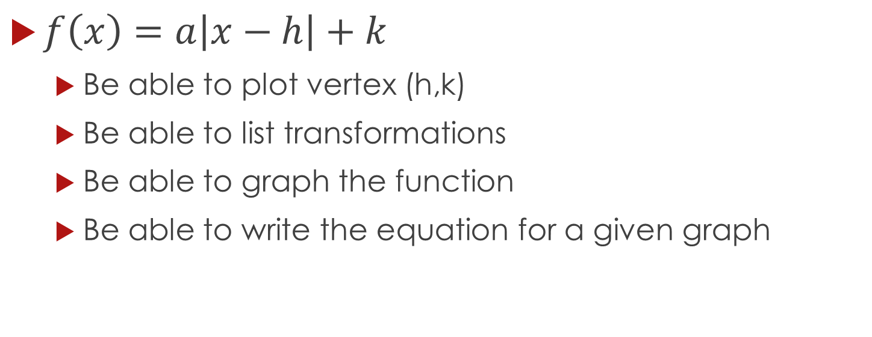
Absolute value functions
$f\left(x\right)=a\left|x−h\right|+k$
Be able to plot vertex (h,k)
Be able to list transformations
Be able to graph the function
Be able to write the equation for a given graph

Slide 5
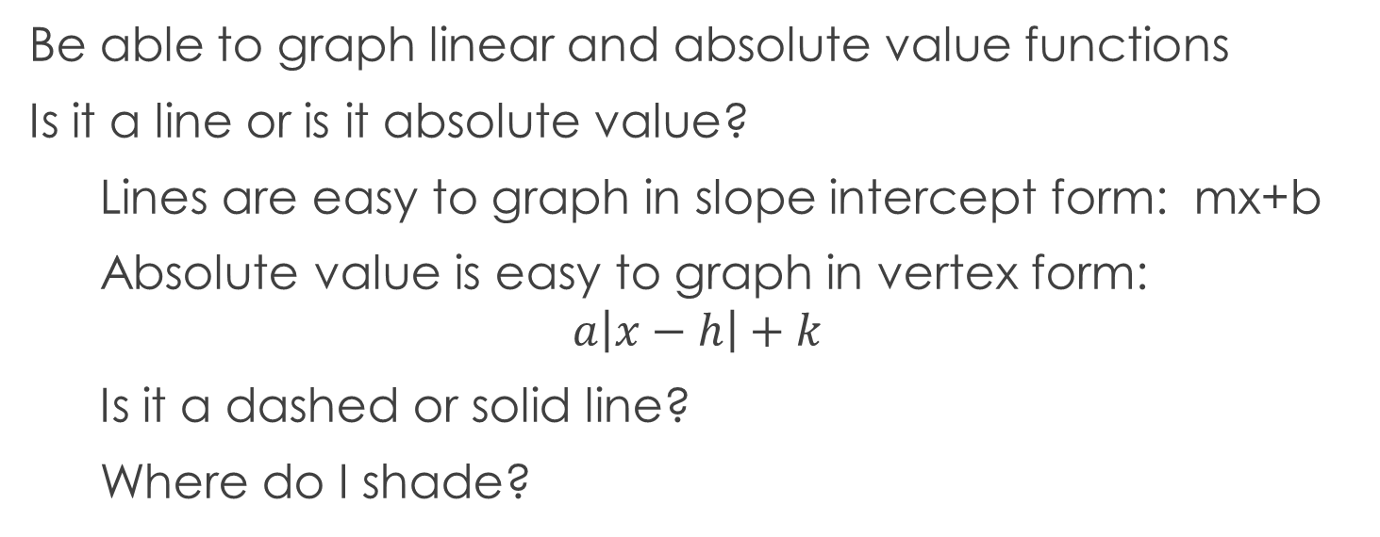
Graphing inequalities
Be able to graph linear and absolute value functions
Is it a line or is it absolute value?
Lines are easy to graph in slope intercept form: mx+b
Absolute value is easy to graph in vertex form:
$$a\left|x−h\right|+k$$
Is it a dashed or solid line?
Where do I shade?

