Slide 1
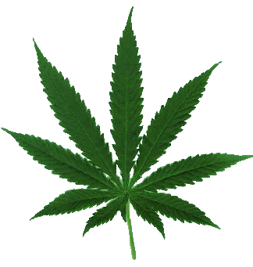
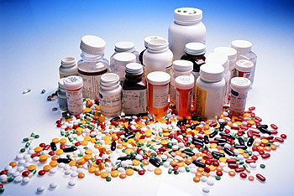
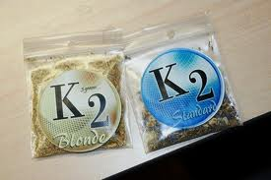
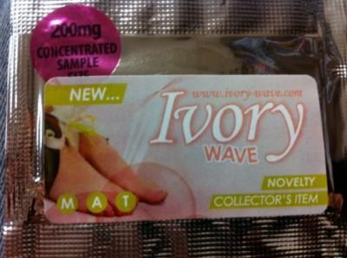
Youth Drug Trends: Marijuana, Medication Misuse, & Synthetic Use Among Teens
Sierra Wright, LMSW
The Regional prevention center of Johnson county
1125 W. Spruce Street
Olathe, ks

Slide 2
The Regional Prevention Center
Notes:
-Located in Olathe -Prevention of substance abuse -Education, such as coming and talking to you all today -Data analysis- CTC surveys taken by 6th, 8th, 10th and 12th graders

Slide 3
What Do You Think?
Is marijuana harmful?
Can you only abuse prescription medication?
Are synthetics legal?
Do you think that marijuana, medication misuse or synthetics are an issue at your school?

Slide 4
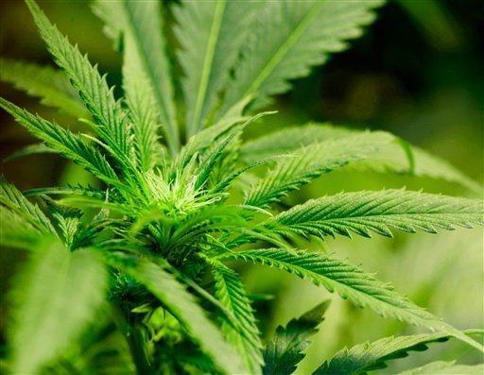
Marijuana
Mind-altering (psychoactive drug)
Most commonly abused illicit substance
THC main ingredient
When smoked, THC passes from the lungs and into the bloodstream, which carries the chemical throughout the body
Effects memory, learning, perception, problem solving and coordination
Can increase the risk of psychosis
DEA
Notes:
-We are going to begin by talking about marijuana, although there are several different names, we will call it marijuana today -Alcohol most commonly abused legal substance -Effects many different parts of the body and can have long term consequences -Something we are seeing now is the increased risk of psychosis meaning marijuana causing a psychotic break in individuals (this caused by a combo of factors but chemical compounds play a large part)
-Marijuana today is up to 10 times more potent then it was in the 60s, 70s and 80s

Slide 5
2012 Johnson County Marijuana Data

Slide 6
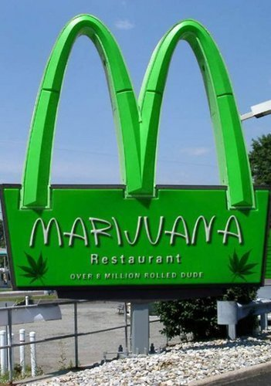
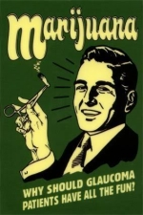
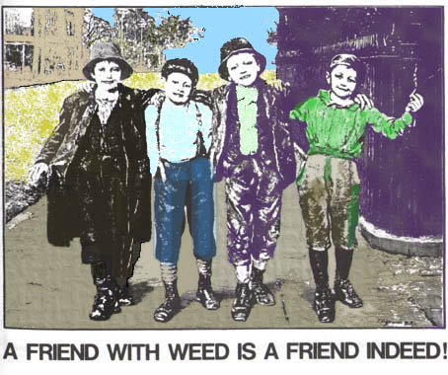
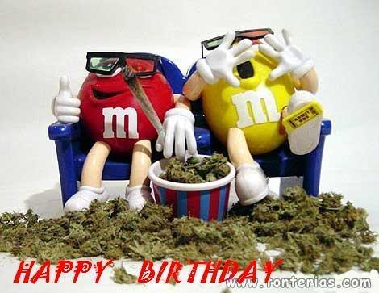
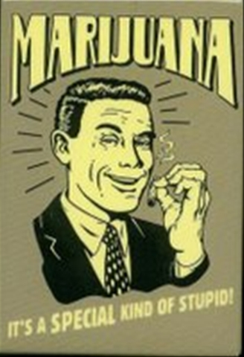
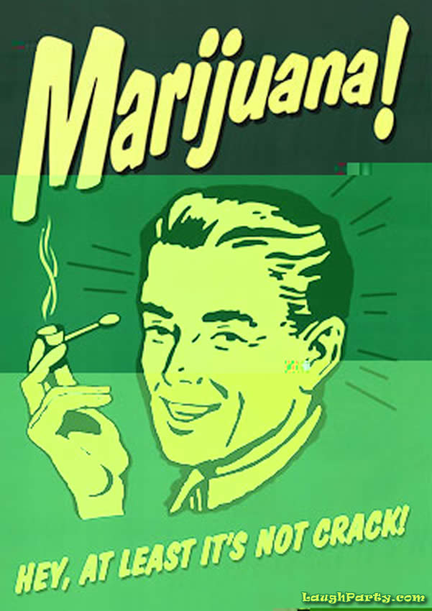
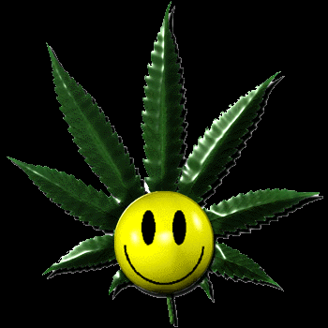
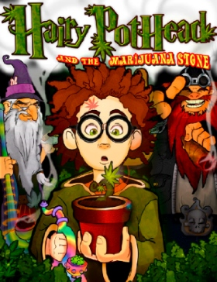
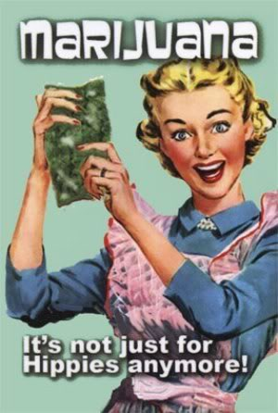
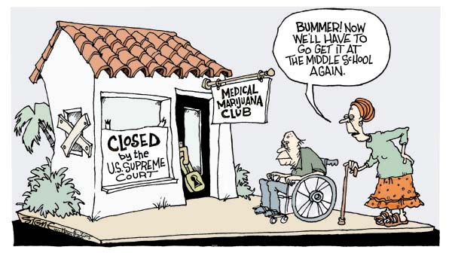
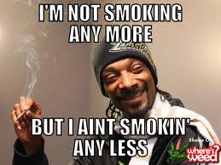
Notes:
-We discussed a little earlier that the perception of harm about marijuana has decreased, meaning that people in our society do not think marijuana is very harmful. Why do you think that might be???
-Discuss medical marijuana dispenseries and the media -Look at some of the images seen in the media about marijuana

Slide 7
Common Marijuana Myths

Slide 8
It’s Natural, So It Can’t Hurt Me
Fiction
Marijuana today is up to 10 times more potent than it was in the 60s, 70s, & 80s
Over 400 chemicals found in marijuana
Marijuana smoke contains 50%-70% more cancer-causing agents than tobacco smoke
Number 1 reason youth admitted for substance abuse treatment in US
Marijuana is addictive; 1 in 6 people under the age of 18 who try it develop a dependence
Kansas Family Partnership
Notes:
-However, despite the media’s portrayal, there are some very serious potential consequences of marijuana. We are going to look at some of the most common myths about marijuana and discuss them.
-The first one, and this is a very common myth, that marijuana is natural, it grows in the ground so it can’t possibly be harmful -Anyone seen the movie Savages? Why their marijuana so popular, bc they could make it so potent -Cigs have around 300 chemicals -People often don’t discuss the addiction factor with marijuana

Slide 9
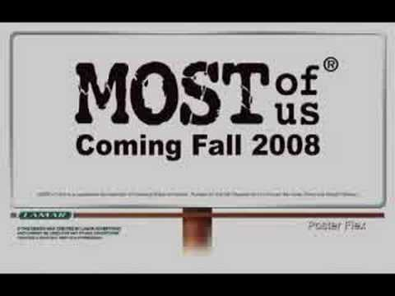
Everyone Does It
Fiction
82% of JoCo youth have NOT use marijuana
89% of JoCo youth have NOT used marijuana in the past 30 days
Youth report 98% of adults in JoCo think it is wrong to use marijuana
90% of JoCo youth reported that they will NOT use marijuana when they are an adult
64% of JoCo youth reported that they would NOT be considered cool if they used marijuana
Ctc data.org
Notes:
-Another common misconception, is that everyone is doing it -Back to the survey we talked about, 82% of joco youth surveyed have not ever used marijuana -All the statistics from JoCo show that most youth are not using

Slide 10
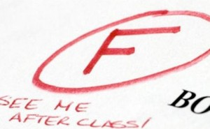
I Do Better In School
Fiction
Marijuana use effects motivation, memory, and learning
Youth with an average grade of D or below were more than 4 times as likely to have used marijuana in the past year than youth with an average grade of A
KFP, CADCA
Notes:
-Next we have the I do better in school myth -Scientific research has shown us that using marijuana decreases motivation, memory and learning. -There is a correlation between youth with failing grades and the likelyhood of them using marijuana

Slide 11
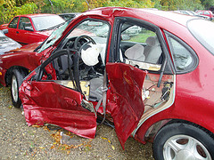
I Drive Better When I Am High
Fiction
Decreases reaction time
Marijuana is the most prevalent illegal drug detected in impaired drivers, fatally injured drivers, and motor vehicle crash victims
20% of crashes in the U.S. are caused by drugged driving
KFP, CADCA
Notes:
-Worked with kids who have said that they drive better when they are high because they pay closer attention -This is false because marijuana decreases your reaction time so you are slower to respond to cars coming into your lane -Huge, marijuana is the most common illegal drug detected in impaired drivers

Slide 12
K2

Slide 13
K2
“Fake weed”
Mixture of herbs and spices that is sprayed with a synthetic compound
Psychological effects similar to marijuana, paranoia, panic attacks, and giddiness
Cause an increased heart rate and blood pressure
Stays in system for long periods of time
DEA
Notes:
-Came out of a research lab with no intention of ever being used for human consumption
-The drug

Slide 14
K2 In The News
KC Ambulance Crew Attacked While Answering Call
Texas Man High on Synthetic Marijuana Kills and Eats Neighbor’s Dog
Man High on Synthetic Marijuana Attacks Couple
Naked ‘Ninja Zombie’
Notes:
-Affecting the entire nation, horrific stories indicating dangerous of k2
KC ambulance crew: April 2012 Police report indicates crew attacked on Saturday afternoon, dispatched for person possibly having seizures. Once they got him into the ambulance, they tried to put blood pressure cuff on him and he kicked worker in the face. Body slammed second worker. Mother reported man high on K2
-Texas man: June 2012, in Waco, 22 year old man strangled and began to eat a neighbors dog who died at the scene. Police found him on the porch covered in blood, initially he was incoherent and unresponsive -Man attacks couple: June 2012, California, attacks elderly couple, charged with suspicion of robbery, burglarly, attempted sexual assault. Forced way into home and forbide them to call the police.
-Naked Zombie: Police were called to the centre of the city after members of the public reported a naked man shouting at passing vehicles.
Arriving at the scene, they encountered an agitated Martin, who refused to follow commands and rushed away from them and started punching at members of the public. Tazed by officers but did not stop him, got up and continued walking.

Slide 15
Bath Salts

Slide 16
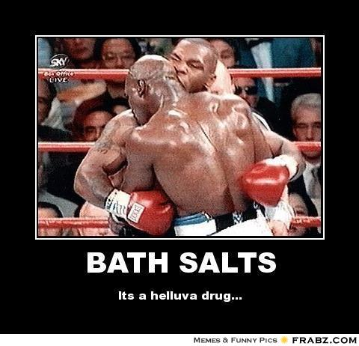
Bath Salts
Not for use in the tub!
Knowledge of long-term effects unknown
High risk for overdose
Dramatic increase in poison center calls
Can cause: chest pains, increased blood pressure, increased heart rate, agitation, hallucinations, extreme paranoia and delusions
Users frequently describe the high as “horrible”
Can require psychiatric treatment
DEA
Bath Salts Video

Slide 17
Medication Misuse

Slide 18
Who is Misusing Medication?
Notes:
-Why chose this picture?
-Hits at the different ages and our drug infused culture -Take a pill for that -Quick fix -Take a pill to treat the side effects of a pill

Slide 19
What is Prescription Drug Misuse?
Taking medication for a purpose other than the reason it was prescribed
Taking a drug not prescribed to you
Taking a drug in a manner or at a dose that was not recommended by a health care professional
Taking medication to get high
Notes:
-Doesn’t have to be someone elses in order to misuse, can be your own
-Doubling up on your medication -Stealing drugs from friend or family member -T

Slide 20
What about Johnson County?
2012 Prescription Drug CTC Data for Johnson County
% Responding “At least once”
Source: ctcdata.org

Slide 21
Prescription Drug Misuse Myths
Prescription medications are safer to abuse than other illicit substances
Unlike marijuana and underage drinking, misusing and sharing prescription medication is legal
Everyone is doing it
Students get their prescriptions from drug dealers
Nothing bad will happen to me or my friends

Slide 22
OTC Medication Misuse
Taking a drug in a higher quantity or in another manner than prescribed
Taking a drug for another purpose than prescribed
Most teens that abuse OTC drugs are not aware that they are doing something dangerous
Great misperception of danger
Can be addictive
Risk for overdose

Slide 23
How Do We Know it’s a Problem?
1 in 5 young adults has abused a prescription drug
1 in 10 youth has abused OTC cough medicine to get high
Over 70% of people who abused prescription drugs got them from friends or family
Prescription drugs are the second most abused category of drugs after marijuana
Source: Prevent Rx Abuse.org

Slide 24
Commonly Abused Prescription Medications
Narcotics
Depressants
Stimulants

Slide 25
Legal, Health,
& Social Consequences

Slide 26
Legal Consequences
Being convicted of a crime related to prescription drug abuse often involves jail or prison time, fines, and possibly a lifelong criminal record
It is illegal to share prescription medications
It is illegal to posses prescription drugs not prescribed specifically for your use
Other factors might increase the penalties (child care facility, public or private school, municipal park, etc)

Slide 27
Health Consequences
Increase blood pressure or heart rate
Damage the brain and other organs
Lead to accidental overdose / poisonings
Cause physical dependency and / or addiction
Disrupt breathing (respiratory depression)
Cause seizures and even death

Slide 28
Social Consequences
Financial trouble
Loss of family & friends
Lack of motivation
Inability to maintain a job
Theft/Legal trouble

Slide 29
Test Your Knowledge
True/False Questions
1. T F Bath salts cannot cause an overdose?
2. T F People who use bath salts often describe it as a “pleasant” high?
3. T F Bath salts can be up to 200 times as toxic as prescription stimulant like Ritalin.
4. T F Vomiting, fever, chills, body aches and insomnia are all symptoms of withdrawals?
5. T F Since K2 is synthetic (man-made) that means it is legal?
6. T F You cannot abuse or misuse OTC (Over The Counter) drugs?
7. T F More than 65% of teens in drug treatment are there due to their dependence upon marijuana?
8. T F Marijuana contains more than 400 different chemicals?
9. T F Marijuana is not addictive?
10. T F Marijuana does not affect learning, memory or motivation?

Slide 30
What Do You Think?
Did you learn anything new today?
Are any of these drugs an issue at your school?
What about our community?
What will you do with your new knowledge?

