Slide 1
0.1 Representing Functions
(yes, I’m serious, the book starts w/Ch 0)

Slide 2
Recall that a relation is a set of ordered pairs.
The domain of a relation is the set of all first coordinates(x-coordinates) from the ordered pairs.
The range is the set of all second coordinates(y-coordinates)from the ordered pairs.

Slide 3
St

Slide 4
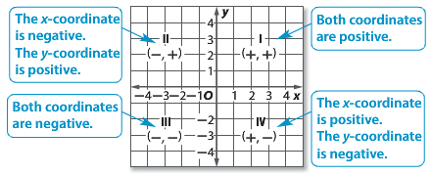
A relation can be graphed on a coordinate plane. There are four quadrants in the plane.

Slide 5
Name the quadrant in which the point P(2, –6) is located.

Slide 6
A relation can also be represented by a table or a mapping. A mapping illustrates how each element of the domain is paired with an element in the range.

Slide 7
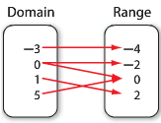
A function is a relation in which each element of the domain is paired with exactly one element of the range.
Is this relation a function?
{(3, 2), (4, 1), (6, 2), (8, 0)}

Slide 8
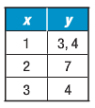
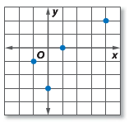
State the domain and range of each relation, then state whether it’s a function or not.

Slide 9
Homework: p P5 - ALL

Slide 10
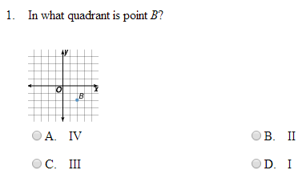

Slide 12
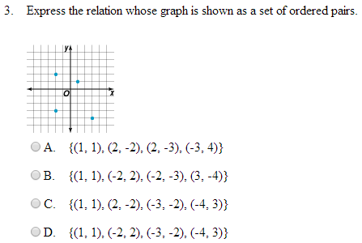

Slide 13
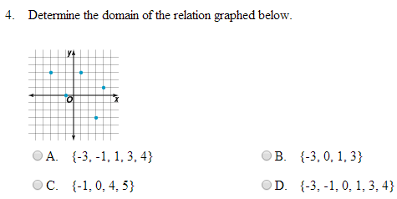

Slide 14
